Slide 1

Computer Networks
Network Layer
S.V.Jansi Rani
Associate Professor / CSE

Slide 2
AGENDA
Network Layer Services
Packet Switching
Network Layer Performance
Congestion Control

Slide 3



Slide 4
Network layer services

Slide 5
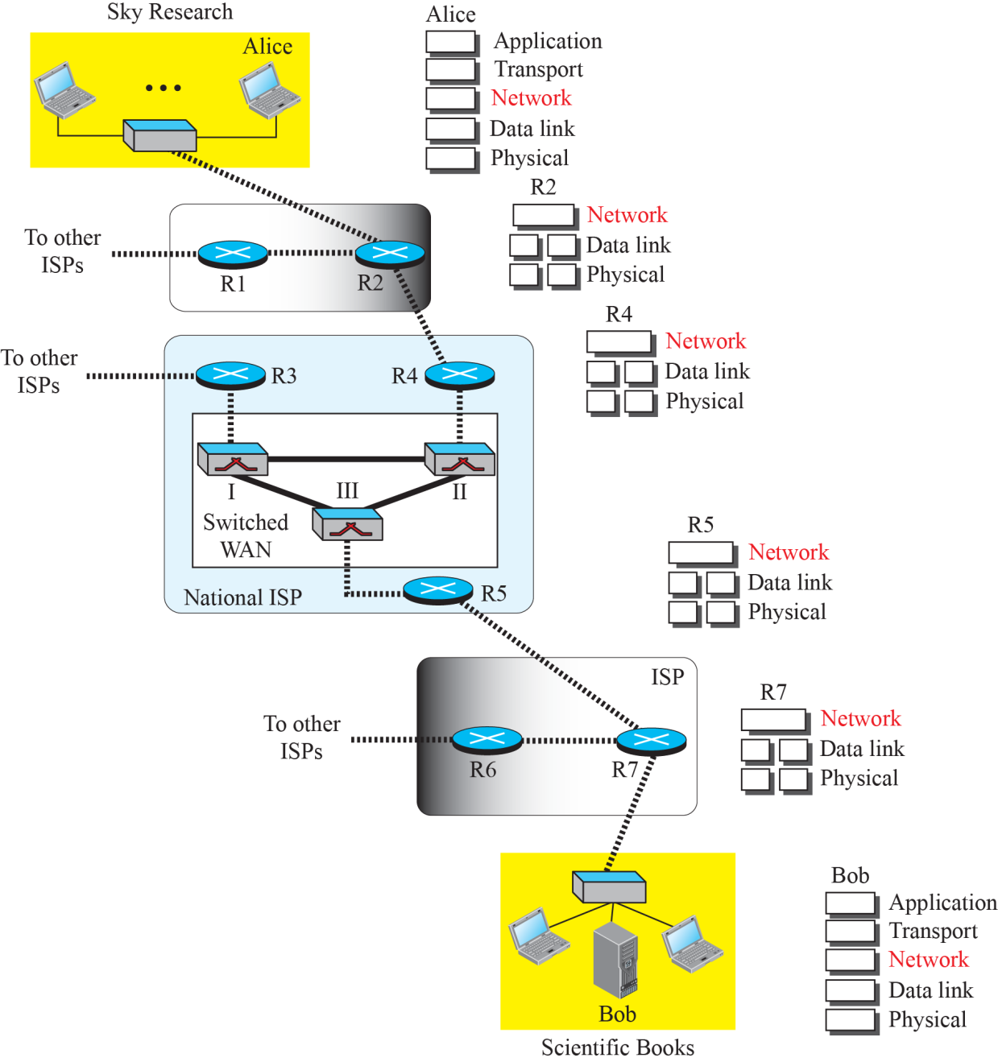
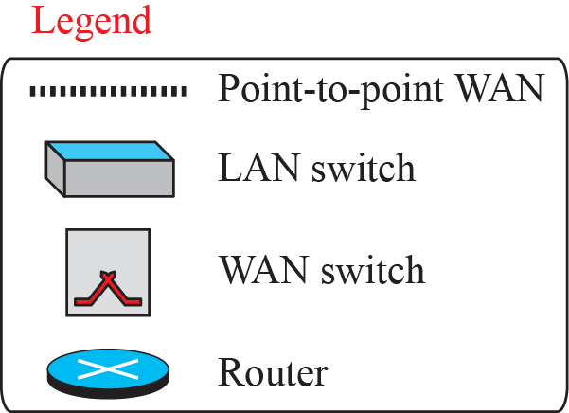
Communication at the network layer

Slide 6
Communication at the network layer
Network layer is involved at the source host, destination host, and all routers in the path (R2, R4, R5, and R7).
At the source host (Alice), the network layer accepts a packet from a transport layer, encapsulates the packet in a datagram, and delivers the packet to the data-link layer.
At the destination host (Bob), the datagram is decapsulated, and the packet is extracted and delivered to the corresponding transport layer
A router in the path is normally shown with two data-link layers and two physical layers, because it receives a packet from one network and delivers it to another network.

Slide 7
Packetizing
The first duty of the network layer is definitely packetizing: encapsulating the payload (data received from upper layer) in a network-layer packet at the source and decapsulating the payload from the network-layer packet at the destination.
Carry a payload from the source to the destination without changing it or using it. Eg.postal office
If the packet is - waiting until all fragments arrive - reassembling -delivering

Slide 8
Routing and Forwarding
Routing
The network layer is responsible for routing the packet from its source to the destination.
The network layer is responsible for finding the best one among these possible routes.
Routing protocols to help the routers coordinate their knowledge about the neighborhood and to come up with consistent tables to be used when a packet arrives.

Slide 9
Routing and Forwarding
Forwarding
Forwarding can be defined as the action applied by each router when a packet arrives at one of its interfaces.
The decision-making table a router normally uses for applying this action is sometimes called the forwarding table and sometimes the routing table.
Router destination address to find the corresponding output interface number in the forwarding table.

Slide 10
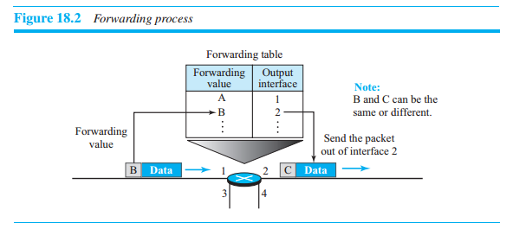
Forwarding process

Slide 11
Other Services
Error Control
No error control
Checksum used for header alone
ICMP is used for datagram
Flow Control
No flow control – upper layer has FC. -> inefficient
Congestion Control
Dropped and send duplicates
Quality of Service
Not available
Security
Not available later in IPSec

Slide 12
PACKET SWITCHING
A router, in fact, is a switch that creates a connection between an input port and an output port (or a set of output ports.

Slide 13
Switching techniques
Circuit switching
Circuit switching is mostly used at the physical layer
Packet switching
Only packet switching is used at the network layer (the unit of data at this layer is a packet).
Datagram approach
Virtual circuit approach.

Slide 14
Datagram Approach
Provides a connectionless service
Network-layer protocol treats each packet independently
Packets in a message may or may not travel the same path to their destination.

Slide 15
Datagram Approach
No resource allocation for a packet.
No reserved bandwidth on the links, and there is no scheduled processing time for each packet.
Resources are allocated on demand. The allocation is done on a first come, first-served basis.
For example, if we do not have a reservation at a restaurant, we might have to wait.

Slide 16
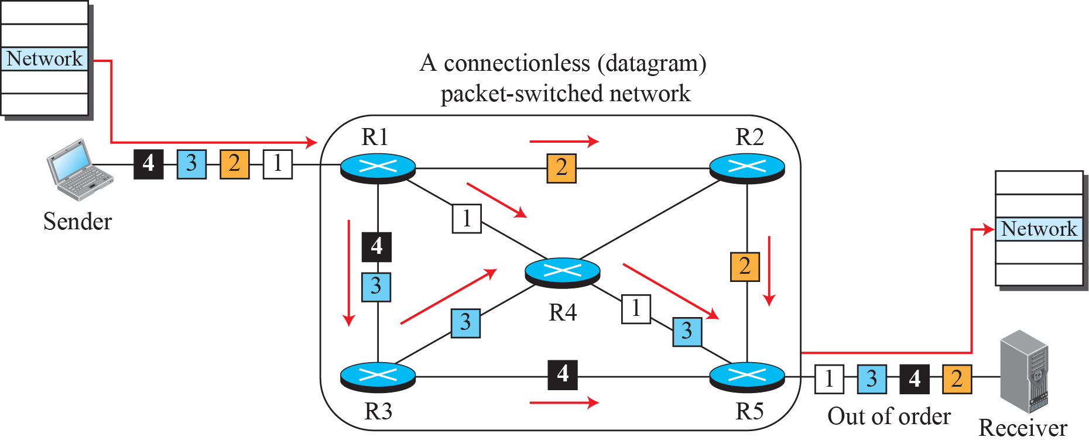
A connectionless packet-switched network

Slide 17
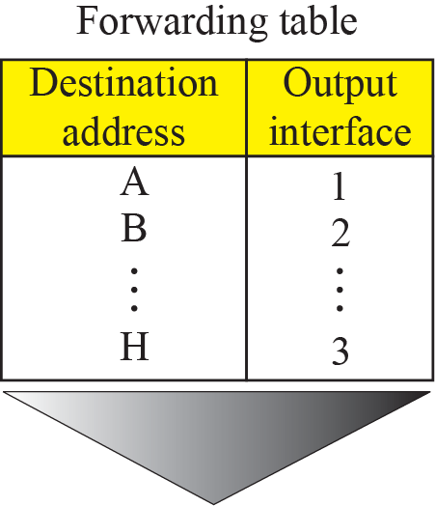
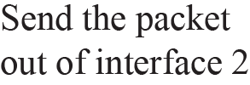
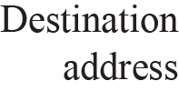
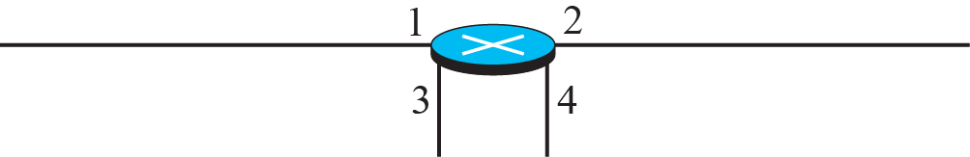
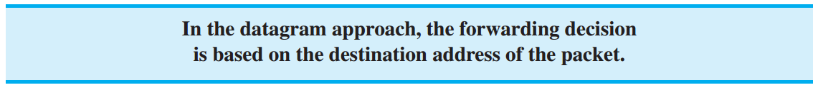
Forwarding process in a router when used in a
connectionless network

Slide 18
Virtual-Circuit Approach
In a connection-oriented service (also called virtual-circuit approach), there is a relationship between all packets belonging to a message.
First, virtual connection should be set up to define the path for the datagrams.
It contain a flow label, a virtual circuit identifier that defines the virtual path the packet should follow

Slide 19
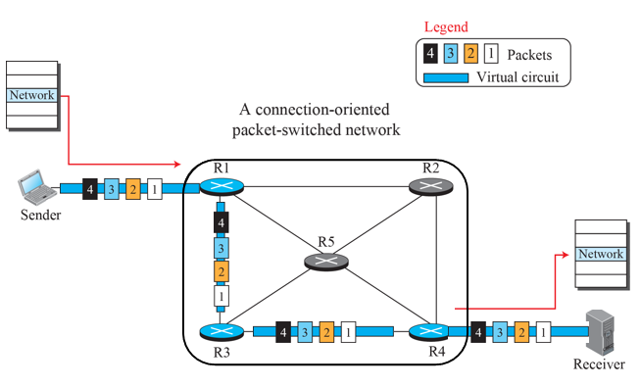
Connection-oriented service.
Four datagrams (1,2,3,4) belonging to the same message follow the same path (Sende→R1→R3→R4→Receiver).

Slide 20
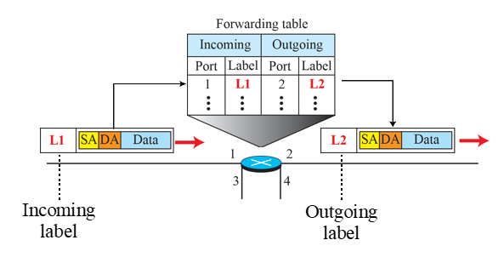
Virtual-Circuit Approach

Slide 21
Virtual-Circuit Approach
To create a connection-oriented service, a three-phase process is used: setup, data transfer, and teardown.
In the setup phase, the source and destination addresses of the sender and receiver are used to make table entries for the connection-oriented service.
In the teardown phase, the source and destination inform the router to delete the corresponding entries.
Data transfer occurs between these two phases.

Slide 22
Virtual-Circuit Approach
Setup phase
In the setup phase, a router creates an entry for a virtual circuit.
For example, suppose source A needs to create a virtual circuit to destination B.
Two auxiliary packets need to be exchanged between the sender and the receiver: the request packet and the acknowledgment packet.

Slide 23
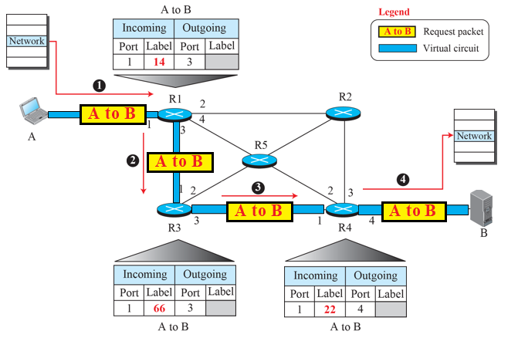
VC Approach – Request Packet

Slide 24
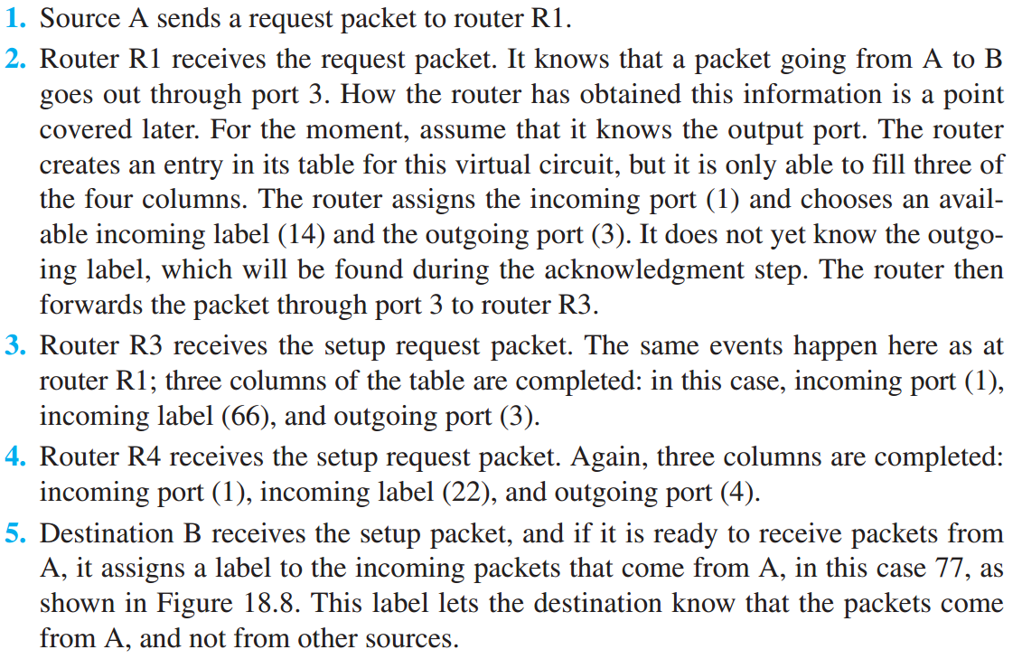
Virtual-Circuit Approach
Setup phase—Request packet

Slide 25
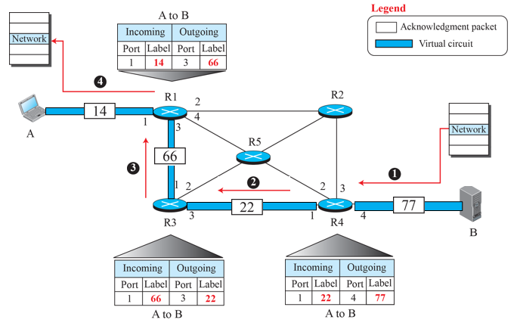
VC Approach – Acknowledgment Packet

Slide 26
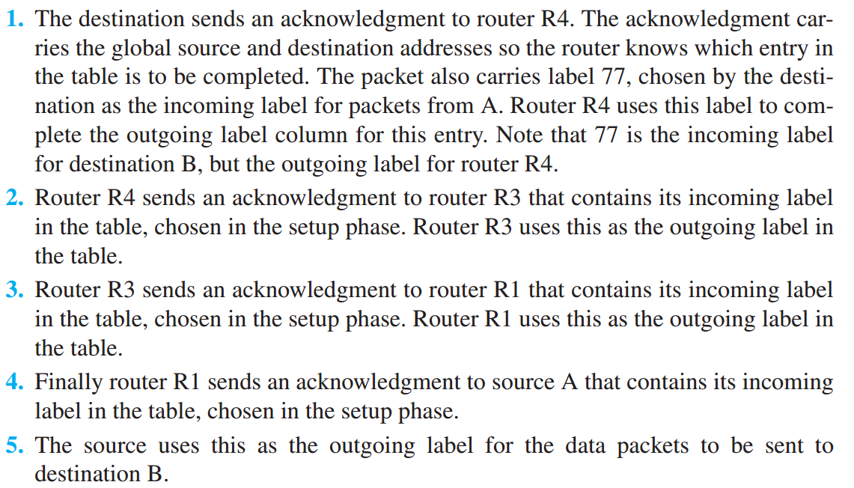
Virtual-Circuit Approach
Setup phase—Acknowledge packet

Slide 27
Virtual-Circuit Approach
Data-Transfer phase
The second phase is called the data-transfer phase. After all routers have created their forwarding table for a specific virtual circuit, then the network-layer packets belonging to one message can be sent one after another. In Figure 18.9, we show the flow of a single packet, but the process is the same for 1, 2, or 100 packets.

Slide 28
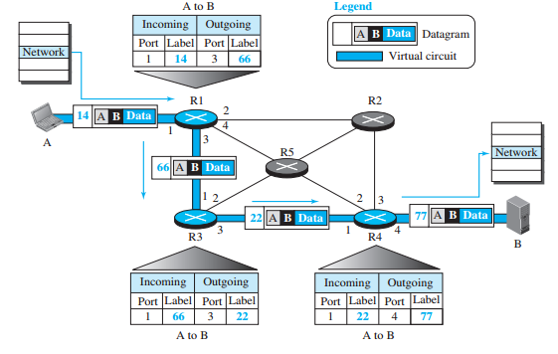
Virtual-Circuit Approach – Data Transfer

Slide 29
Virtual-Circuit Approach
Teardown phase
In the teardown phase, source A, after sending all packets to B, sends a special packet called a teardown packet. Destination B responds with a confirmation packet. All routers delete the corresponding entries from their tables.

Slide 30
NETWORK-LAYER PERFORMANCE
The performance of a network can be measured in terms of delay, throughput, and packet loss.
Congestion control is an issue that can improve the performance.

Slide 31
Delay
All of us expect instantaneous response from a network, but a packet, from its source to its destination, encounters delays.
The delays in a network can be divided into four types: transmission delay, propagation delay, processing delay, and queuing delay.

Slide 32
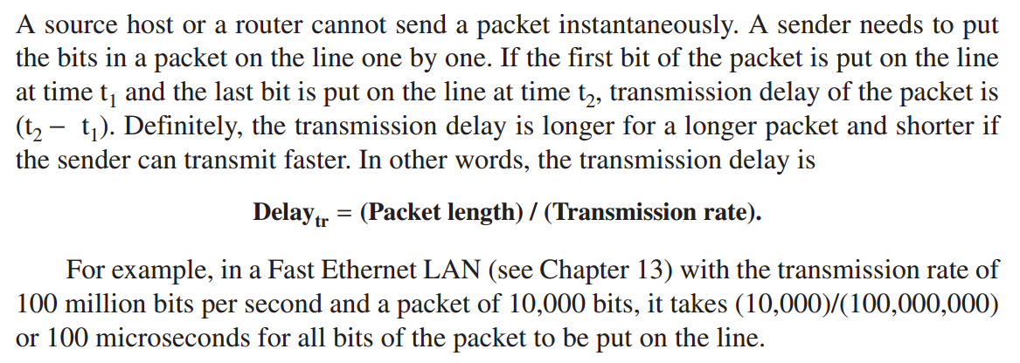
Delay
Transmission delay

Slide 33
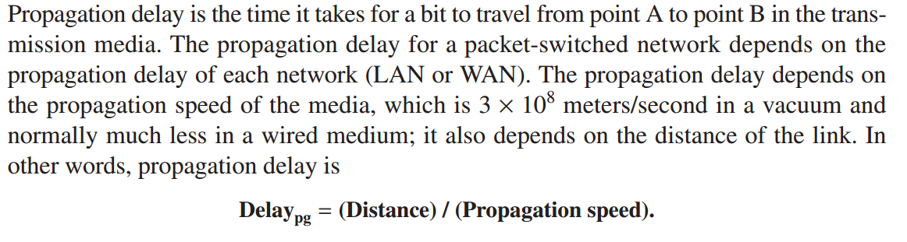
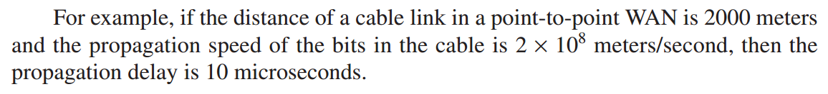
Delay
Propagation delay

Slide 34
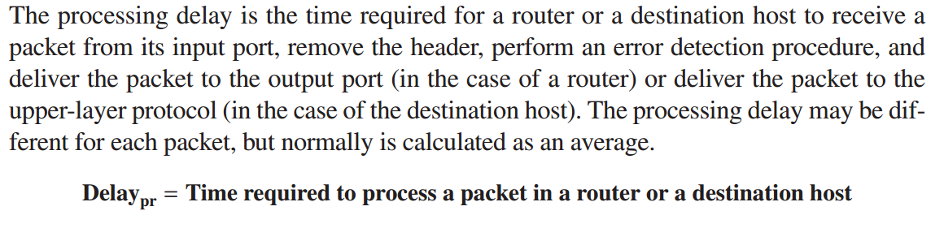
Delay
Processing delay

Slide 35
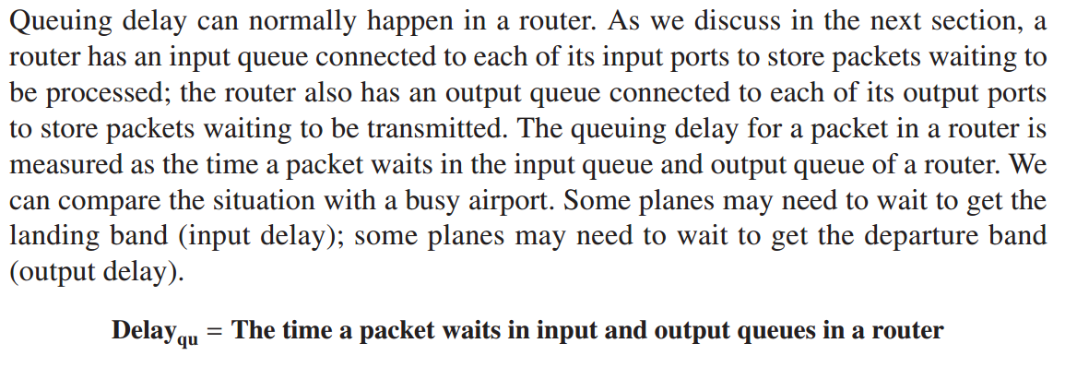
Delay
Queuing delay

Slide 36
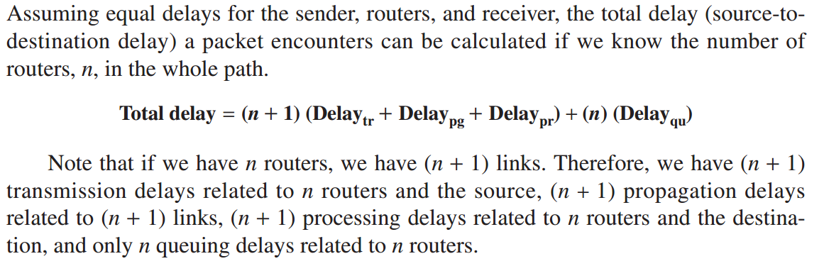
Delay
Total delay

Slide 37
Throughput
Throughput at any point in a network is defined as the number of bits passing through the point in a second, which is actually the transmission rate of data at that point.
In a path from source to destination, a packet may pass through several links (networks), each with a different transmission rate.
How, then, can we determine the throughput of the whole path?

Slide 38
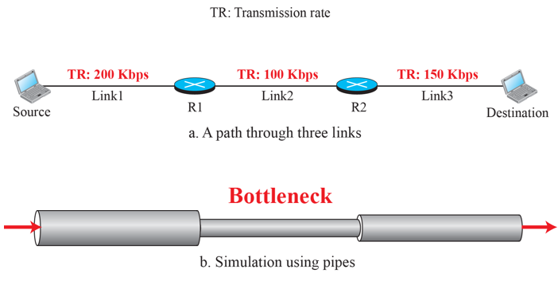
Throughput
To see the situation, assume that we have three links, each with a different transmission rate.

Slide 39
Throughput
In this figure, the data can flow at the rate of 200 kbps in Link1. However, when the data arrives at router R1, it cannot pass at this rate. Data needs to be queued at the router and sent at 100 kbps. When data arrives at router R2, it could be sent at the rate of 150 kbps, but there is not enough data to be sent. In other words, the average rate of the data flow in Link3 is also 100 kbps. We can conclude that the average data rate for this path is 100 kbps, the minimum of the three different data rates.

Slide 40
Throughput
Average throughput is determined by the bottleneck, the pipe with the smallest diameter. In general, in a path with n links in series, we have

Slide 41
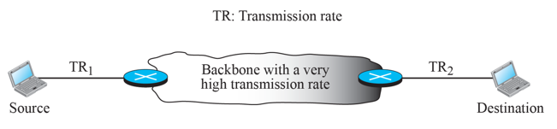
Throughput
The Internet - if a server connects to the Internet via a Fast Ethernet LAN with the data rate of 100 Mbps, but a user who wants to download a file connects to the Internet via a dial-up telephone line with the data rate of 40 kbps
Throughput - 40 kbps.

Slide 42
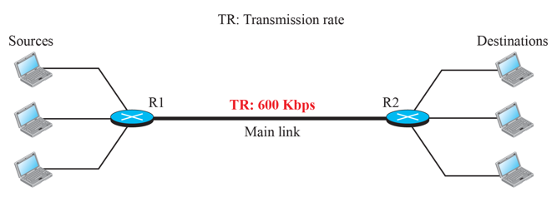
Throughput
Throughput is only 200 kbps because the link is shared between three paths.

Slide 43
Packet Loss
Another issue that severely affects the performance of communication is the number of packets lost during transmission.
When a router receives a packet - buffer is full -next packet dropped.
Effect of packet loss - resent, which in turn may create overflow and cause more packet loss.

Slide 44
Congestion Control
Congestion control is a mechanism for improving performance.
Congestion at the network layer is related to two issues, throughput and delay.

Slide 45
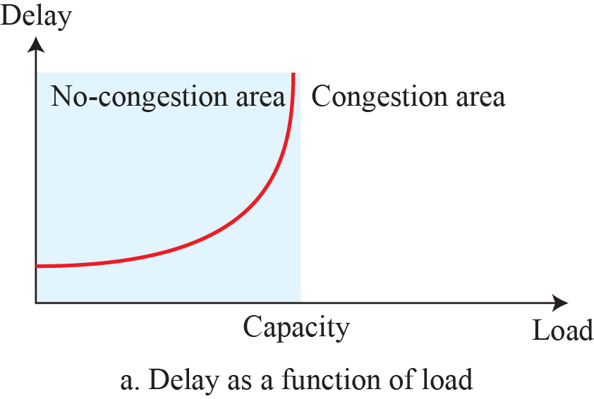
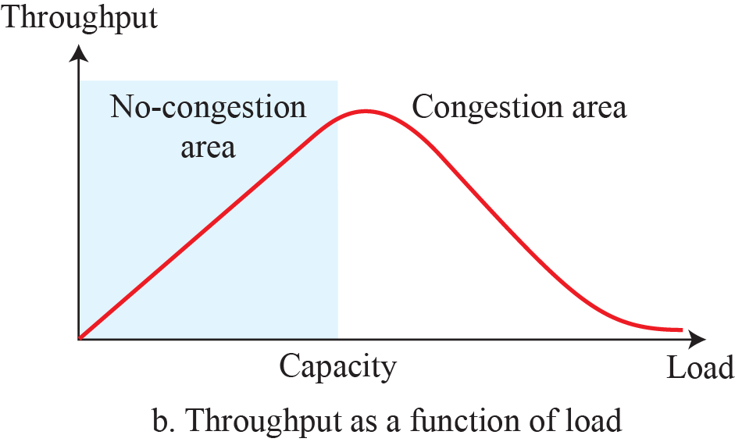
Congestion Control
Graph shows throughput and delay as functions of load.

Slide 46
Congestion Control
Congestion control refers to techniques and mechanisms that can either prevent congestion before it happens or remove congestion after it has happened.
Two broad categories:
Open-loop congestion control (prevention)
Closed-loop congestion control (removal).

Slide 47
Congestion Control
Open-loop congestion control
In open-loop congestion control, policies are applied to prevent congestion before it happens
Handled by either the source or the destination.
List of policies that can prevent congestion.
Retransmission policy
Window policy
Acknowledgement policy
Discarding policy
Admission policy

Slide 48
Congestion Control
Closed-loop congestion control
Closed-loop congestion control mechanisms try to alleviate congestion after it happens.
Several mechanisms have been used by different protocols
Back pressure
Choke Packet
Implicit signaling
Explicit signaling

Slide 49
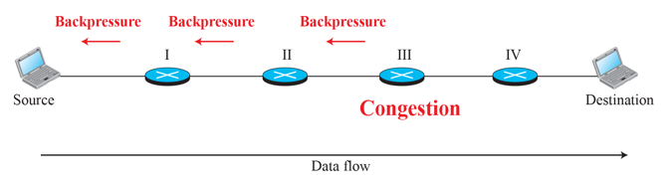
Congestion Control
Closed-loop congestion control—Backpressure –in VC

Slide 50
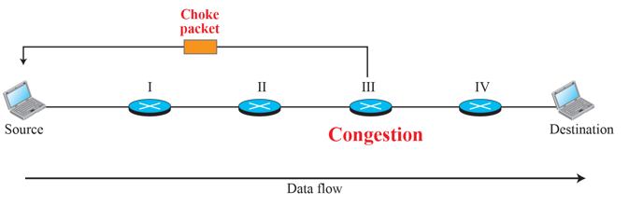
Congestion Control
Closed-loop congestion control
Choke Packet A choke packet

Slide 51
Check Your Understanding
List out the network layer service
How choke and back pressure differs
What are the performance factors related to network layer?

Slide 52
Outcome
Student should be able to understand
Network Layer Services
Packet Switching
Network Layer Performance
Congestion Control

Slide 53
THANK YOU

